Slide 1
Removing Unwanted Caption from Snapchat Images
Matt Giovannucci
David Tigreros

Slide 2
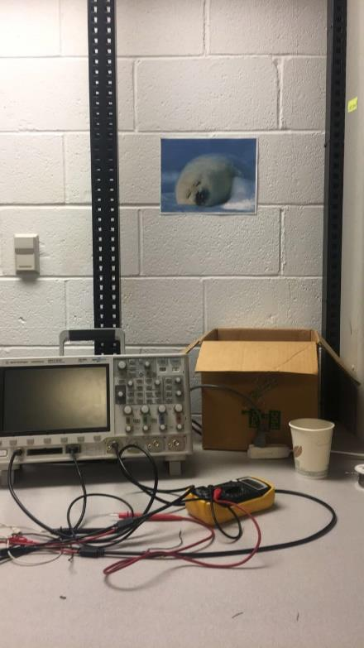
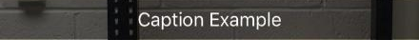

Slide 3
Several Pre-existing methods
CapSnap, Python Based program
CaptionClean – iPhone App

Slide 4
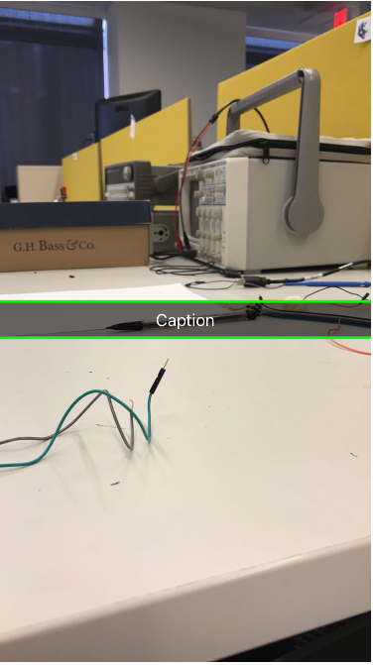
Isolating Snapchat bar
Using the Hough transform to find straight lines within picture
Filter the lines to only look for horizontal lines

Slide 5
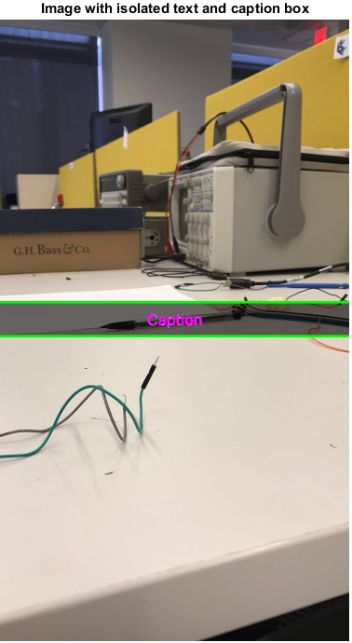
Isolating The Text
Binarize image so that there is high contrast between text and the rest of the image (similar to Lab 6)
Use caption box boundary to ensure only the text is isolated

Slide 6
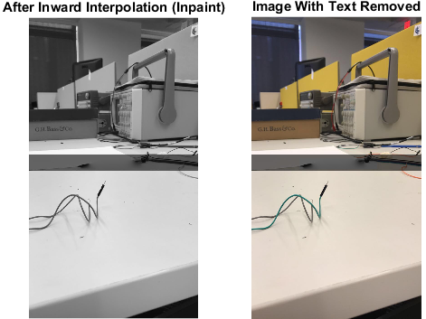
Removing The Text
Using text pixel values identify text region boundary
Fill in specified region in image using inward interpolation (must be grayscale)
Replace RGB values of grayscale image with values of original pixels, except in text region

Slide 7
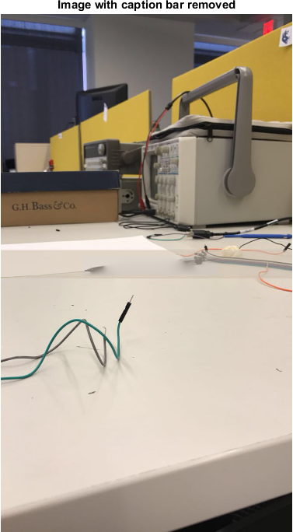
Blend snapchat bar into the surrounding picture
Average surrounding pixels into the picture
Take five random rows surrounding the bar and find the average difference between each RGB value of a random pixel within the bar in the same row

